Slide 1

MSDS-6306-Fall-2019 Case Study 02 – Employee Attrition
Sachin Chavan
12/06/2019
Youtube link - https://youtu.be/AdvavD-SqRU
Github link - https://github.com/sachinac/smu_msds_6306/tree/master/msds_project_02

Slide 2
Introduction to Dataset DDSAnalytics dataset
Goal
Identify factors that lead to
attrition and build a model to
predict attrition.
Non Predictors (5) | Nominal Categorical (7) | Ordinal Categorical (9) | Numerical (14)
ID EmployeeNumber EmployeeCount StandardHours Over18 | BusinessTravel Department EducationField Gender JobRole MaritalStatus OverTime Attrition | Education EnvironmentSatisfaction JobInvolvement JobLevel JobSatisfaction PerformanceRating RelationshipSatisfaction StockOptionLevel WorkLifeBalance | Age DailyRate DistanceFromHome HourlyRate MonthlyIncome MonthlyRate NumCompaniesWorked PercentSalaryHike TotalWorkingYears TrainingTimesLastYear YearsAtCompany YearsInCurrentRole YearsSinceLastPromotion YearsWithCurrManager
Response Classification Problem | Response Regression Problem
Attrition | MonthlyIncome
Total Records | Total Fields
870 | 36

Slide 3
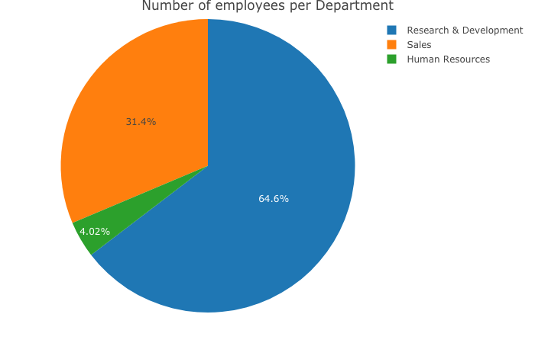
Distribution of employees
Department | Employees
Research & Development | 562
Sales | 273
Human Resource | 35

Slide 4
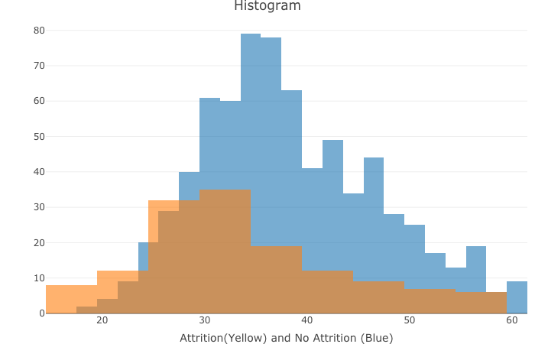
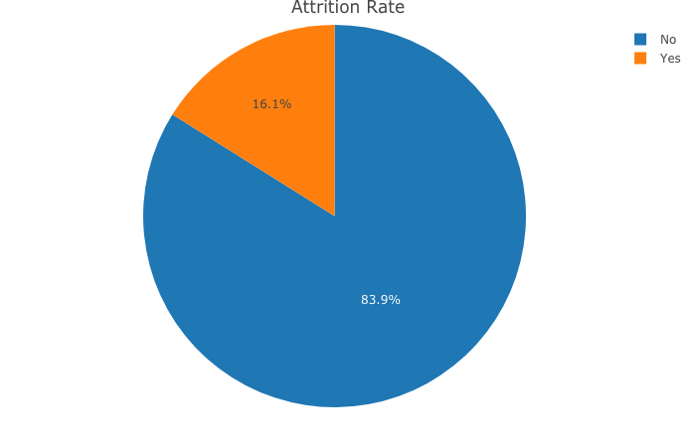
Distribution of attrition
Mean Age of organization – 37
Mean Age of attrition – 33
Total Employees – 870
Attrition - 140

Slide 5
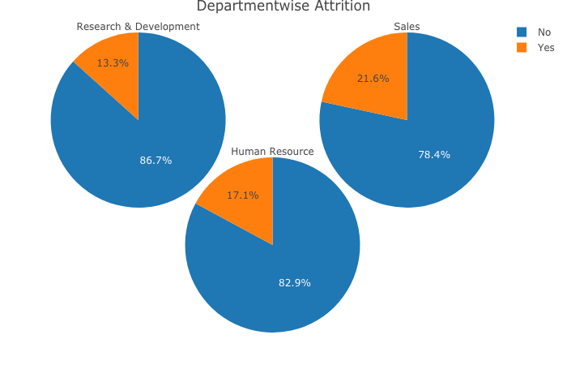
Attrition - Department wise
Department | Total Employees | Attrition
R & D | 562 | 75
Sales | 273 | 59
Human Resource | 35 | 6

Slide 6
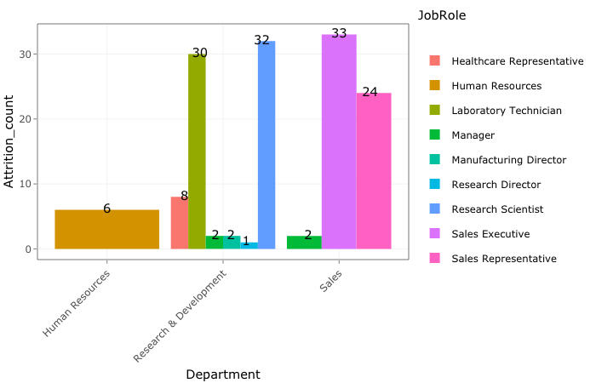
Roles within Department Attrition

Slide 7
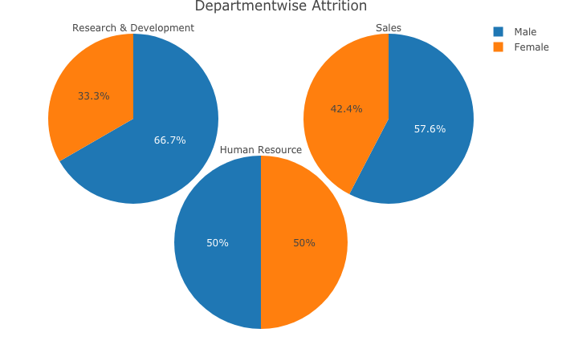
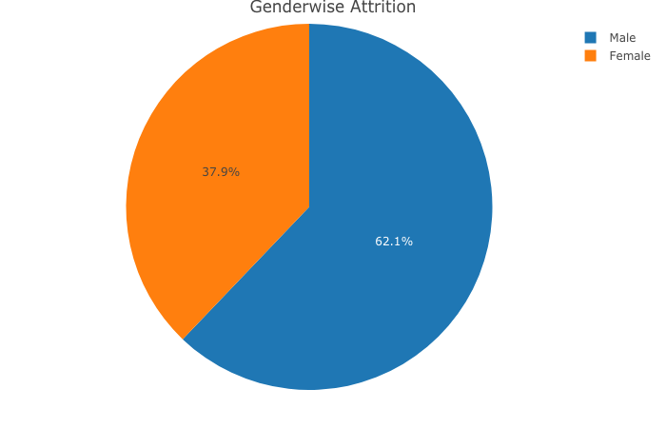
Attrition by Gender
Gender | Total Employees | Attrition
Male | 516 | 87
Female | 354 | 53

Slide 8
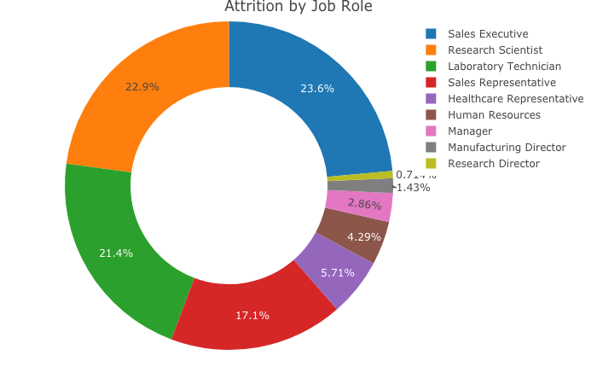
Attrition by Job Role

Slide 9
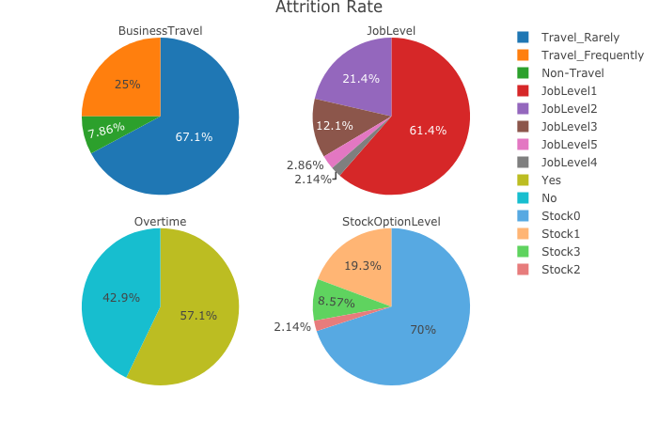
Top 4
JobLevel | Attrition
1 | 86
2 | 30
3 | 17
4 | 3
5 | 4
StockOption | Attrition
0 | 98
1 | 27
2 | 3
3 | 12
Business Travel | Attrition
Non-Travel | 11
Travel Frequently | 35
Travel Rarely | 94
Overtime | Attrition
Yes | 80
No | 60

Slide 10
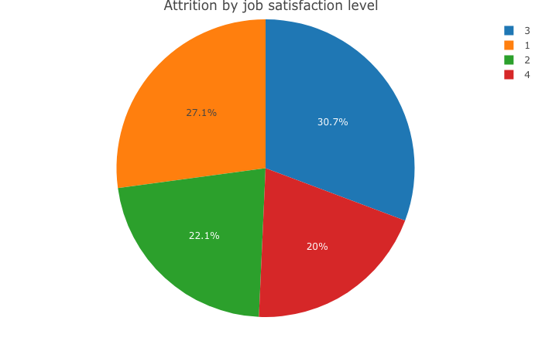
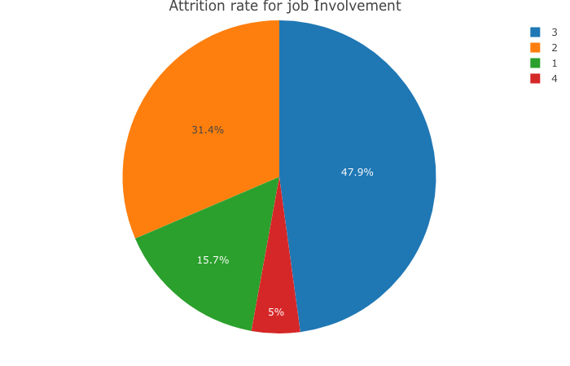
Attrition by satisfaction Level

Slide 11
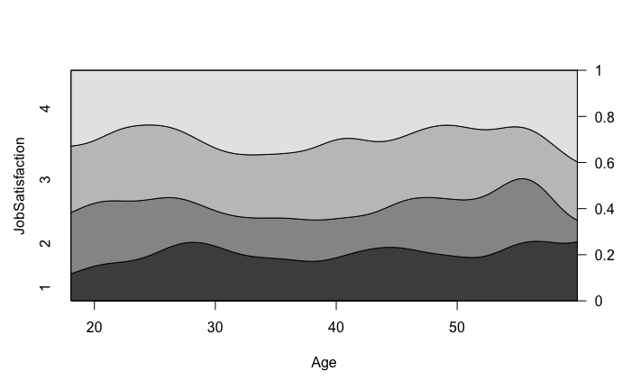
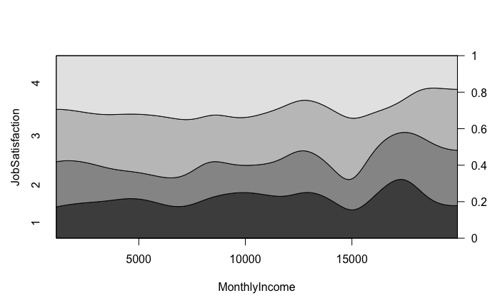
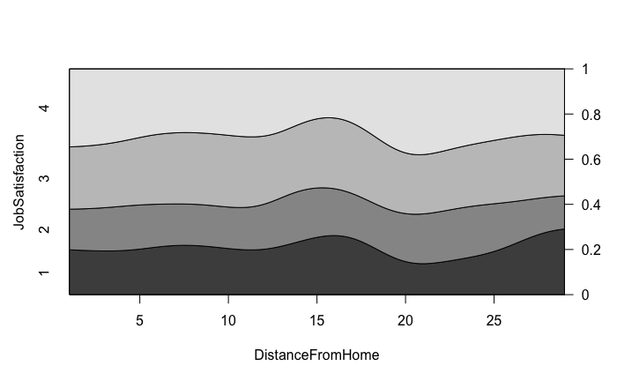
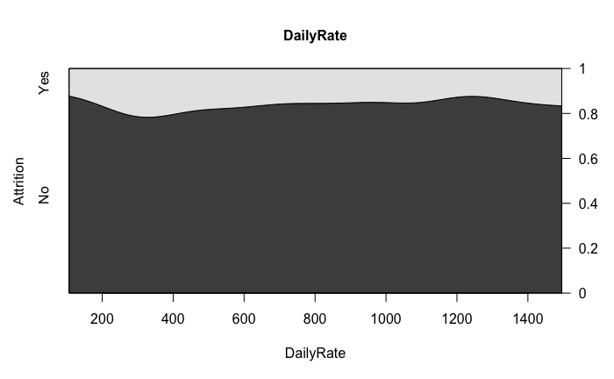
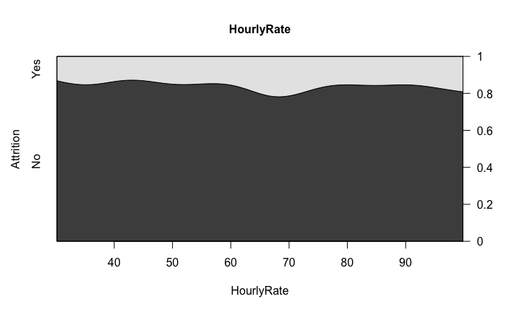
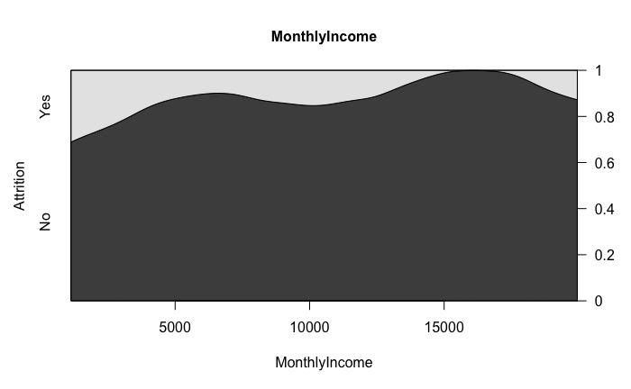
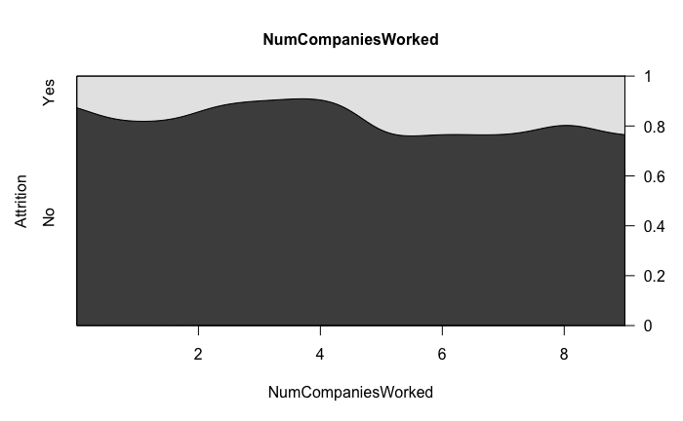
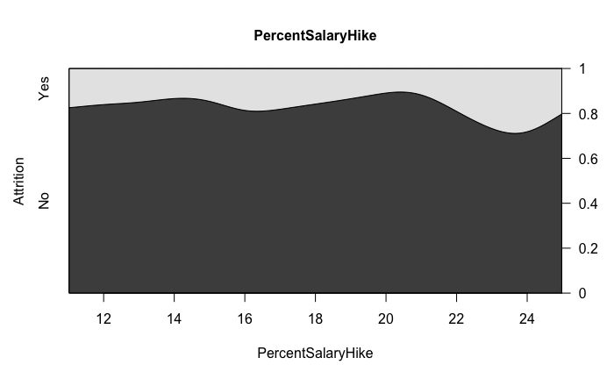
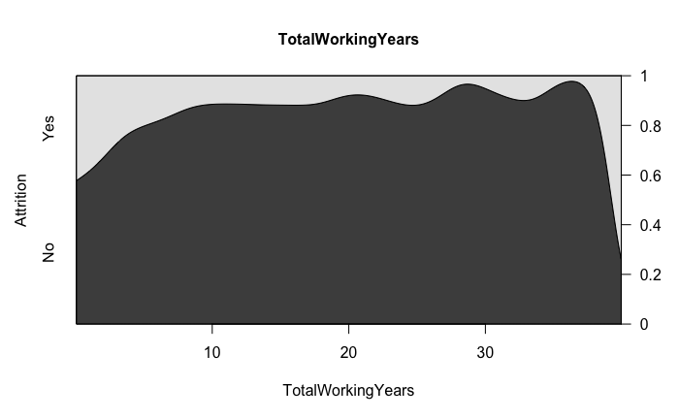
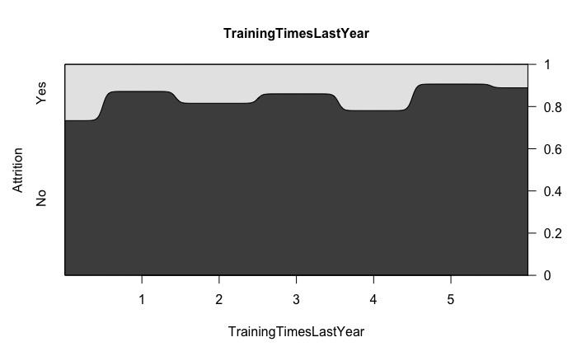
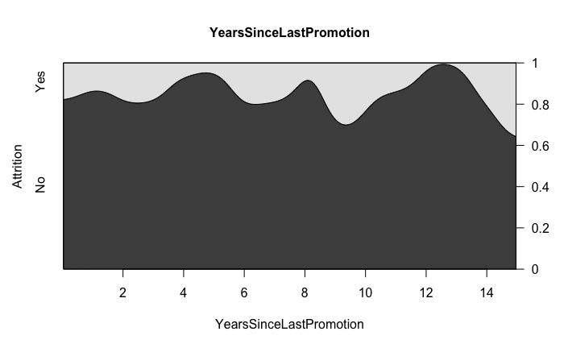
Density Plots for Numeric Predictors
Job satisfaction Vs
Numeric Predictors
Attrition Vs
Numeric predictors

Slide 12
Hypothesis Tests categorical predictors
Ho – All levels of the factor are same. i.e. there is no difference in
contribution to attrition between levels of the factor
Ha – At least one level is significantly contributing to attrition than
other levels
Factor | Decision | P-Value
BusinessTravel | Fail to reject | 0.06
Department | Reject | 0.01
EducationField | Fail to reject | 0.24
Gender | Fail to reject | 0.51
JobRole | Reject | 0
MaritalStatus | Reject | 0
OverTime | Reject | 0
Factor | Decision | P-Value
Education | Fail to reject | 0.65
EnvironmentSatisfaction | reject | 0.01
JobInvolvement | reject | 0
JobLevel | reject | 0
JobSatisfaction | reject | 0.01
PerformanceRating | Fail to reject | 0.07
RelationshipSatisfaction | Fail to reject | 0.38
StockOptionLevel | reject | 0
WorkLifeBalance | reject | 0.1
Fisher test was conducted for hypothesis
Test.

Slide 13
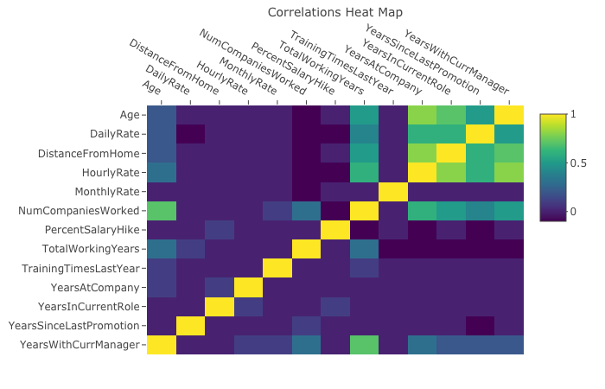
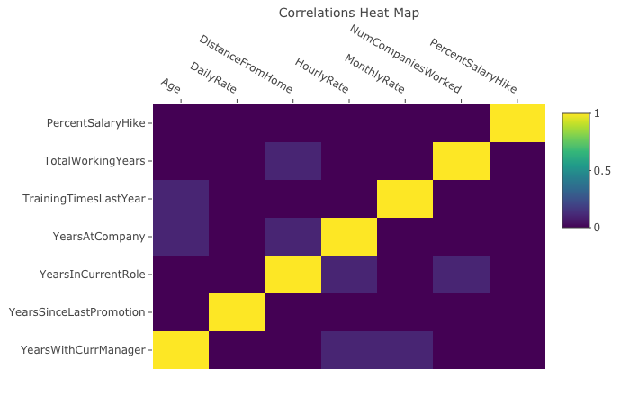
Heatmap
Before Removing co-related variables
After Removing co-related variables

Slide 14
Classification Models K nearest neighbor
Model | kNN (k=9) | Naïve Bayes | Random forest
Accuracy | 0.7471 | 0.6839 | 0.7241
Sensitivity | 0.6786 | 0.8214 | 0.8214
Specificity | 0.7603 | 0.6575 | 0.7055
Misclassification | 0.2528 | 0.3160 | 0.2758

Slide 15
Classification Model Feature Importance

Slide 16
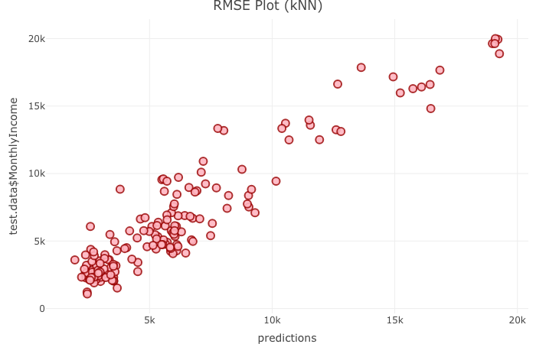
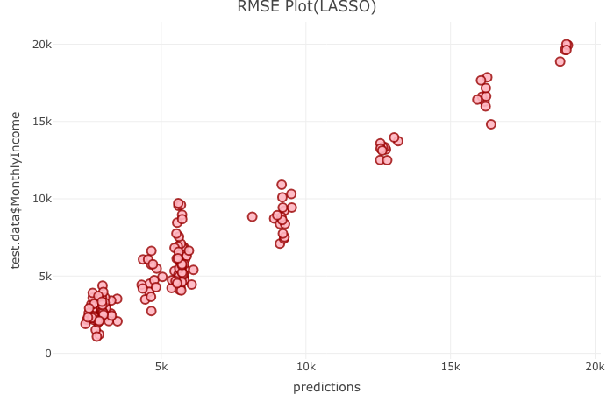
Regression Models
Model | RMSE | R-square
kNN regression | 1565.399 | 0.8871423
Penalized regression (LASSO) | 1084.64 | 0.9433065

Slide 17
Conclusion
Top 6 factors that leads to attrition that determined by our models are as follows. Three of which are matching to EDA
Stock Options
Overtime
Job Level
Job Role
Age
MonthlyIncome
23 Research Scientist, Most of the lab technicians, 33 Sales Representative and Sales executive were both overloaded and without any stock options.
Our model has captured that accurately

